Slide 1
Money Laundering Classification using Machine Learning.
By
Tarique Anwar
Email: tarique.dhs@gmail.com

Slide 2
Introduction:
Money laundering the process of accumulation huge amount of money through illegal source of income. These money moves through foreign bank and legal businesses to make it appear legal. These activities not only just weaken the financial institution but it also effects the overall economy.

Slide 3
Money Laundering Resources:
Drug trafficking
Smuggling
Online Fraud
Organized crime
Tax Evasion
And many more..

Slide 4
How machine learning can tackle money laundering issues?
There are many ways machine learning can help to tackle money laundering issues few of them are as follows:
Pattern Recognition
Real-Time Monitoring
Adaptive Learning
Anomaly Detection

Slide 5

Project Objectives:
Our project aims to build a machine learning model that can identify and classify fraudulent transactions from a given dataset.

Slide 6
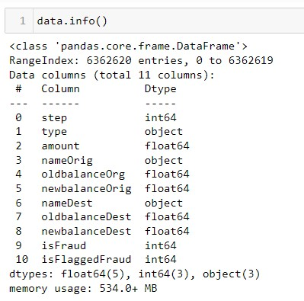
Dataset Overview:
The dataset consists of 11 columns (variables) and a total of 6,362,620 records taken from a financial dataset.

Slide 7
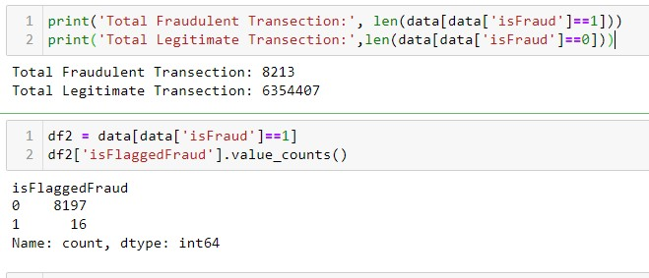
Basic Insights:
Total number of fraudulent transection in records = 8213.
Total number of flagged transection having transection amount more than 200000 in single transection =16.
All 16 flagged transection are fraudulent transection.

Slide 8
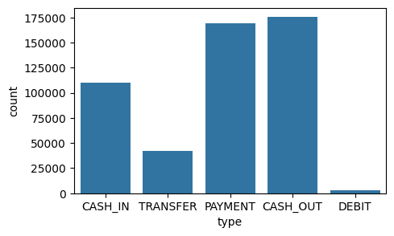
Analysis of transection type based on count:
Insight-1:
Transection type “PAYMENT” & “CASH_OUT” are the most frequent transection in overall data set.

Slide 9
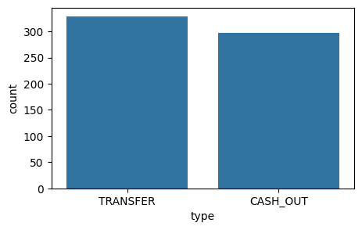
Analysis of fraud transection based on count:
Insight-2:
In fraud transection “TRANSFER” & “CASH_OUT” type are the most frequent transection.
These two types are mostly contributing in fraud transection, we need to handle it.

Slide 10
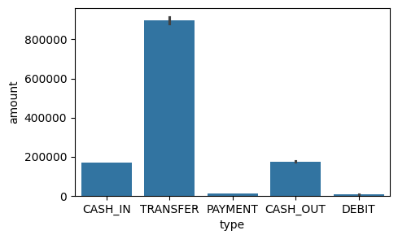
Analysis of transection based on amount on overall data:
Insight-3:
Transection type ‘TRANSFER’
has maximum “amount” that has been transferred as per the record in overall data.

Slide 11
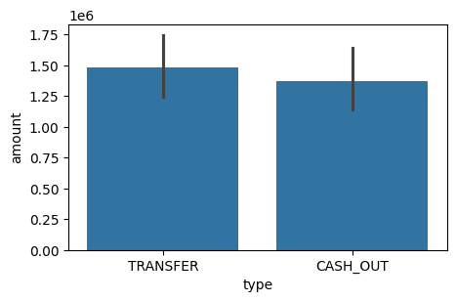
Analysis of fraud transection based on amount:
Insight-4:
The maximum amount that has been transferred through transection type “TRANSFER” and “CASH_OUT” which are contributing to fraud transection.
Here transection limit should be placed to mitigate the risk of fraud transection.

Slide 12
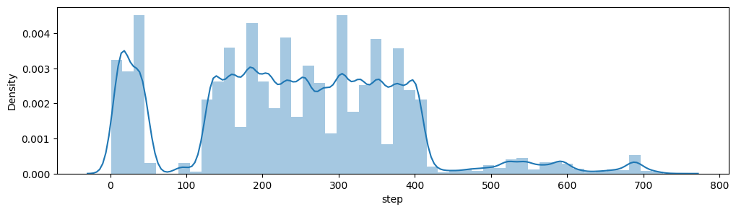
Distribution of time in overall data:
Most of the transection are occurred withing the time limit of 0 to 400, where at time 100 and beyond time 400 there are minimum transection are recorded in over all datasets.

Slide 13
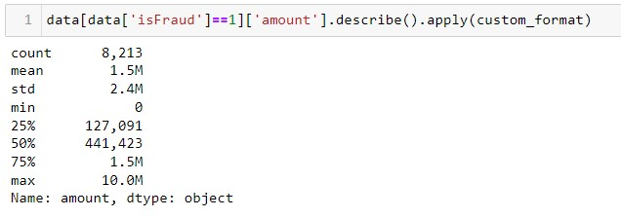
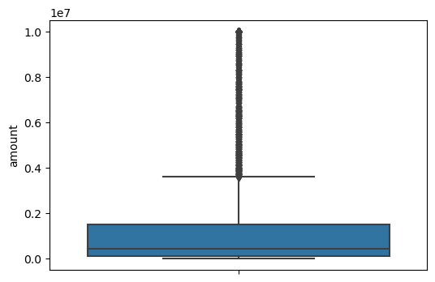
Analysis of fraud transection on the basis of amount:

Slide 14
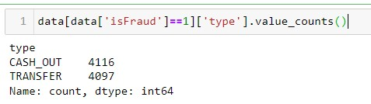
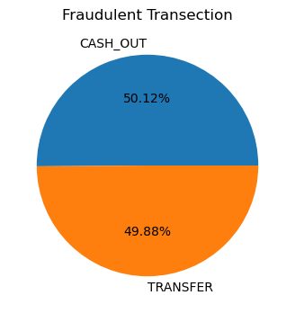
Analysis of fraud transection on the basis of transection type:

Slide 15
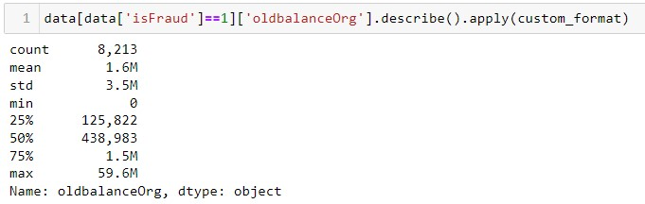
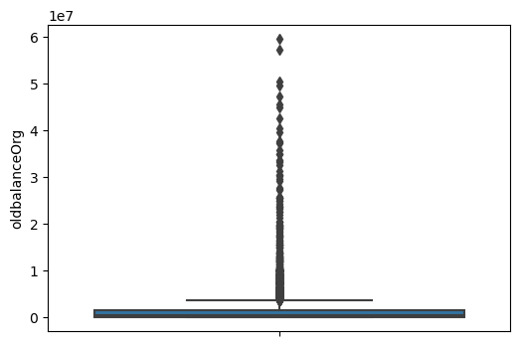
Analysis of fraud transection on the basis of oldbalanceOrg:

Slide 16
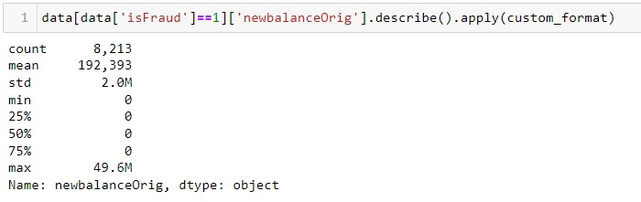
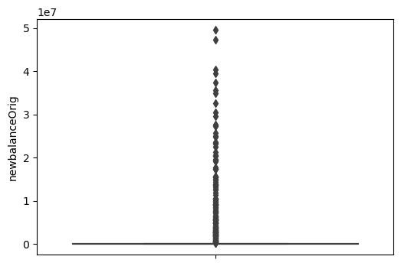
Analysis of fraud transection on the basis of newbalanceOrig:

Slide 17
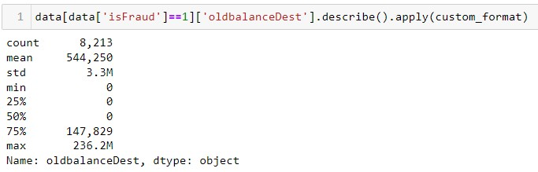
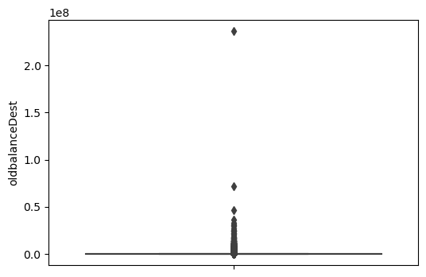
Analysis of fraud transection on the basis of oldbalanceDest:

Slide 18
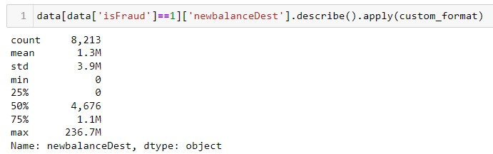
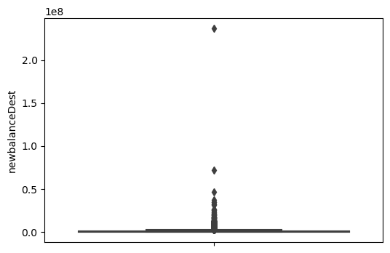
Analysis of fraud transection on the basis of newbalanceDest:

Slide 19
Data Preprocessing
(Preparing data for model building.)

Slide 20
Data Preprocessing:
Steps followed:
Dropping non-significant variables.
Label encoding by creating dummies variable and dropping first.
Data balancing using “RandomOverSampler”.
Data normalization using “MinMaxScaler”.
Applying PCA for dimension reduction.
Separating predictor and target variable.

Slide 21
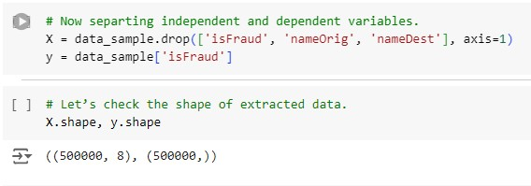
Separating predictor and target variables while dropping non-significant variable:

Slide 22
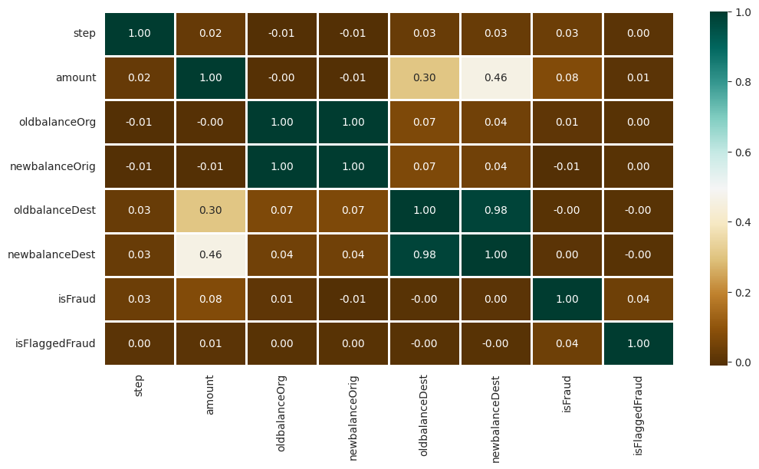
Correlation Analysis:

Slide 23
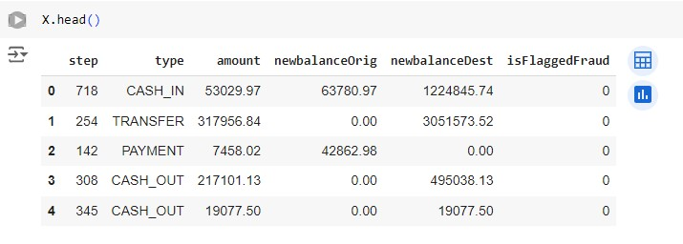
Dropping highly correlated variables:

Slide 24
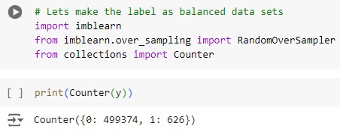
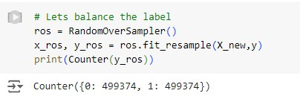
Balancing datasets:
Imbalance Dataset
Balanced Dataset

Slide 25
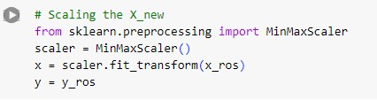
Scaling the data:

Slide 26
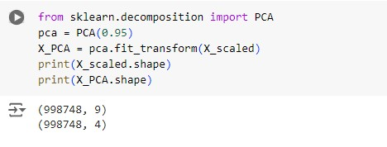
Applying PCA:

Slide 27
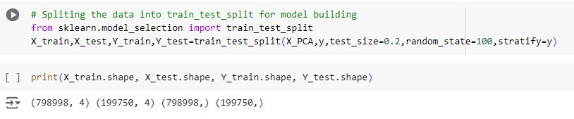
Splitting the data into train_test_split:

Slide 28
Model Training & Selection:
Logistic Regression: Mean Accuracy = 0.8013, Std = 0.0016
Random Forest: Mean Accuracy = 0.9998, Std = 0.0001
K-Nearest Neighbors: Mean Accuracy = 0.9991, Std = 0.0001
Decision Tree: Mean Accuracy = 0.9997, Std = 0.0000
XGBClassifier: Mean Accuracy = 0.9657, Std = 0.0018

Slide 29
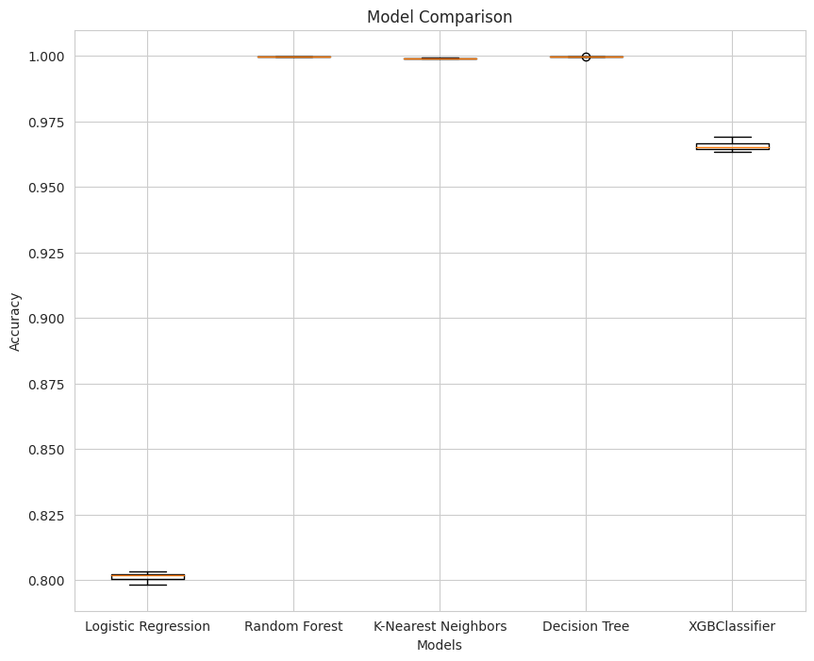
Model Training & Selection:

Slide 30
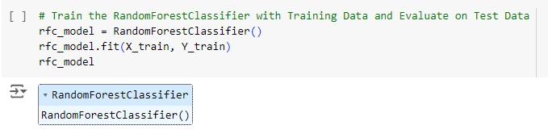
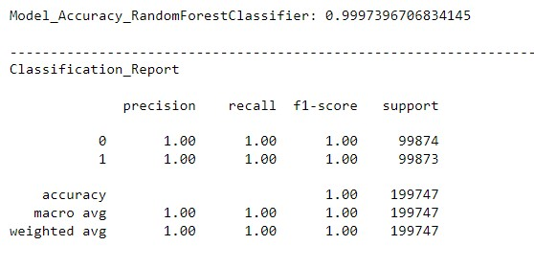
Training the best model:

Slide 31
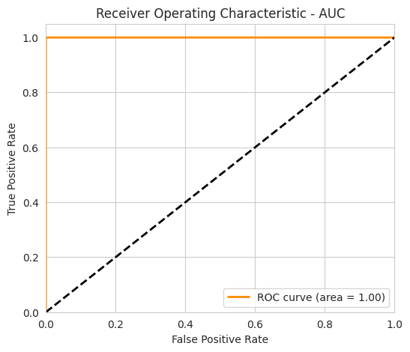
Model Evaluation:

Slide 32
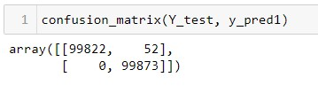
Confusion Matrix :
Type-1 Error: There are 55 transection which model has predicted as Fraud transection, which is actually not a fraud transection.
Type-2 Error: There is 0 False Negative which means model has 100% correctly predicted all fraudulent transection.

Slide 33
Conclusion:
Our machine learning model for online payment fraud detection significantly enhances the security and reliability of financial transactions by accurately identifying fraudulent activities, thus protecting both businesses and customers, this innovation not only reduces financial losses but also strengthens trust in digital payment systems.

